Slide 1
Predicting Shear Fracture Growth in Sandstone
Harsh Vora
11/16/2018

Slide 2
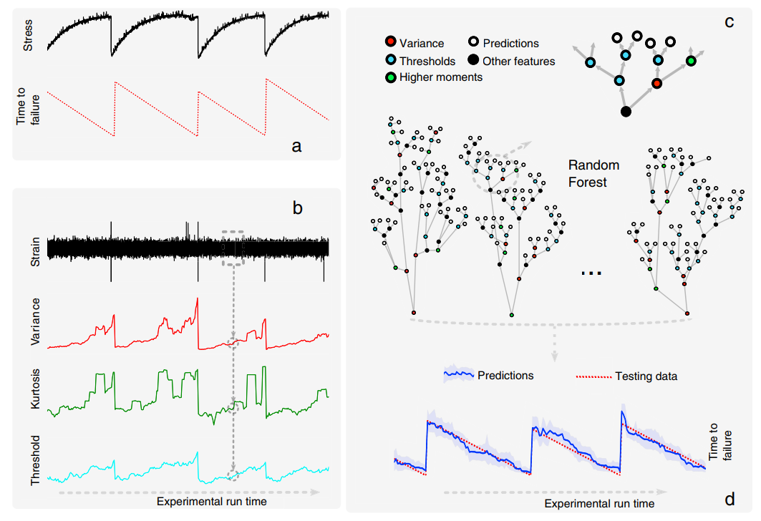
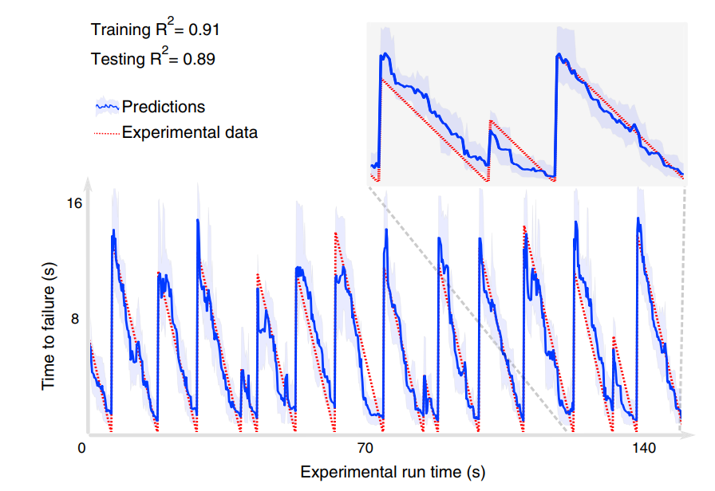
ML predicts failure in stick-slip experiments
Rouet-Leduc et al., 2017:
Variance of AE energy shows strongest correlation
AI can be used to predict time to failure
Notes:
But
1. they used it on pre-fractured rock and failure is a function of friction.
2. They only use knowledge of fracture energy

Slide 3
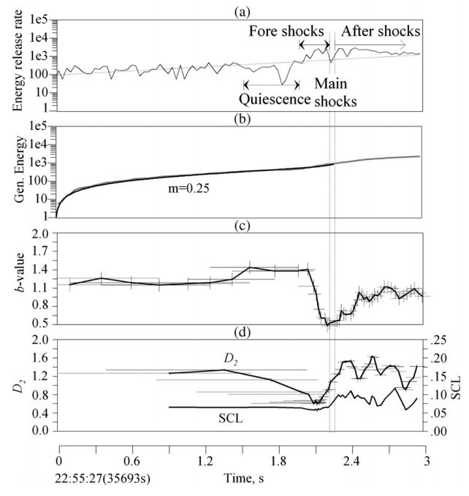
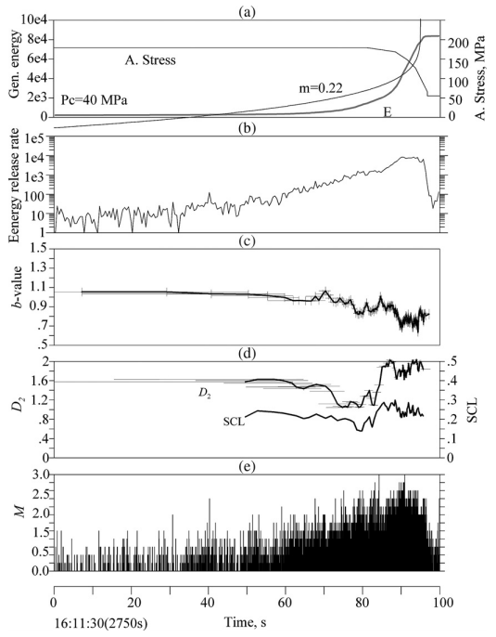
Precursory Signatures (Lei et al., 2006)
Granite
schist
Prior to failure:
Increase in Energy Release Rate
Decline in b-values
Decline in D-values
Notes:
Identify various precursors
But do not build a predictive tool

Slide 4
Objectives
“Each parameter is a function of the temporal distance to the critical point”
“An integrated analysis of two or more parameters may lead to more effective means of predicting time of the critical point”
Quantify temporal signatures of deformation in granular rock
Can they be combined to build a predictive tool?

Slide 5
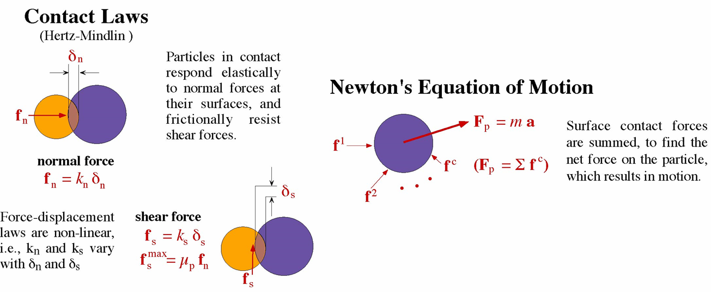

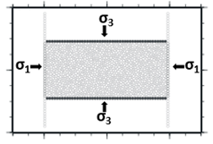
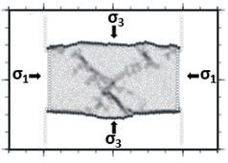
Experiments using Discrete Element Method
σ_{pre}
Induced Bonds can fail in different modes:
Tensile
Shear
Rotation

Slide 6
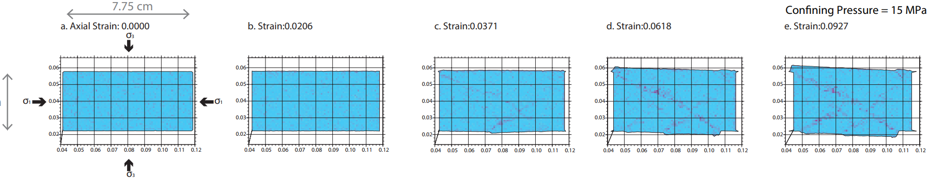
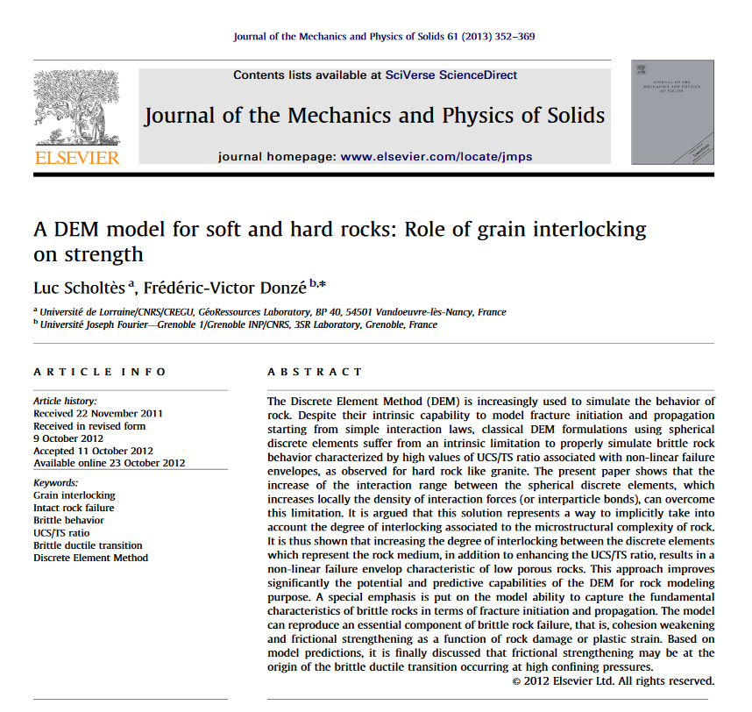
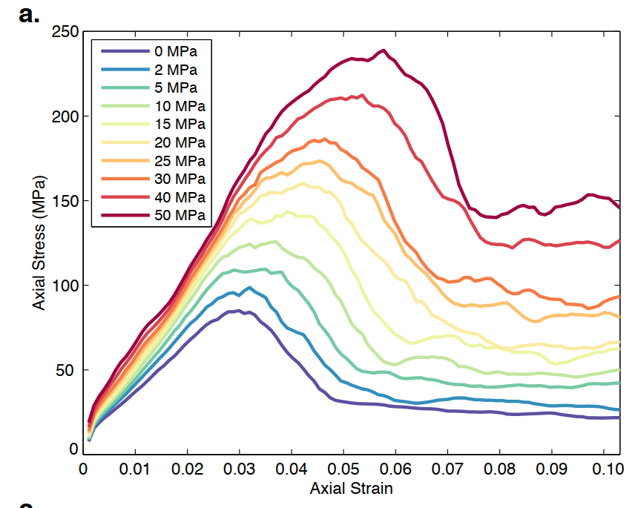
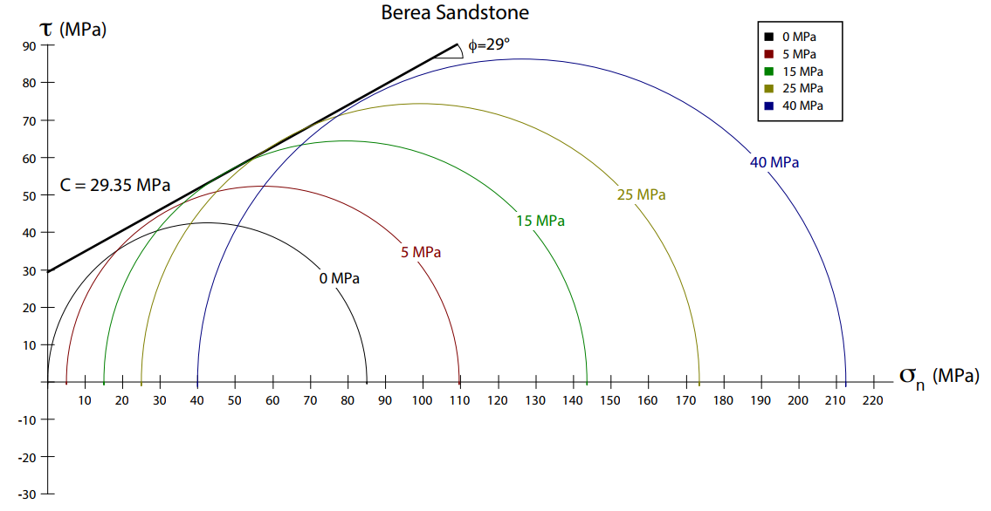
Biaxial Experiments on Berea Sandstone
3 .8 cm
Parameter | Modeled | Experimental
UCS (MPa) | 85.05 | 95.00
Young’s Modulus (Pa) | 4.28 | 7.50
MC Cohesion (Pa) | 29.35 | 26.10
MC Slope | 0.55 | 0.49

Slide 7
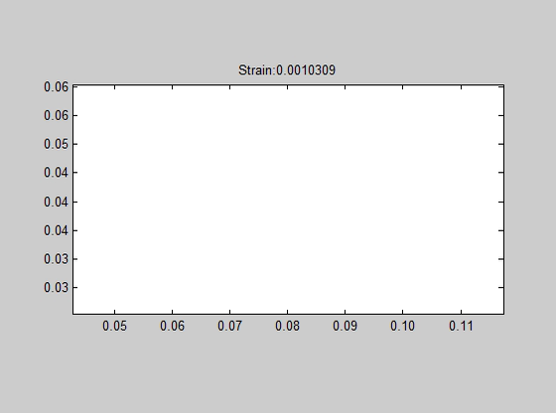
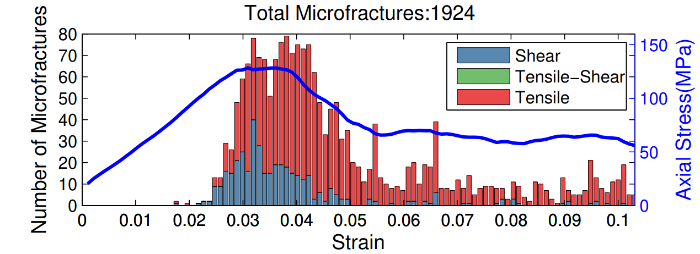
Method 1: Microcrack Growth
3 .8 cm

Slide 8
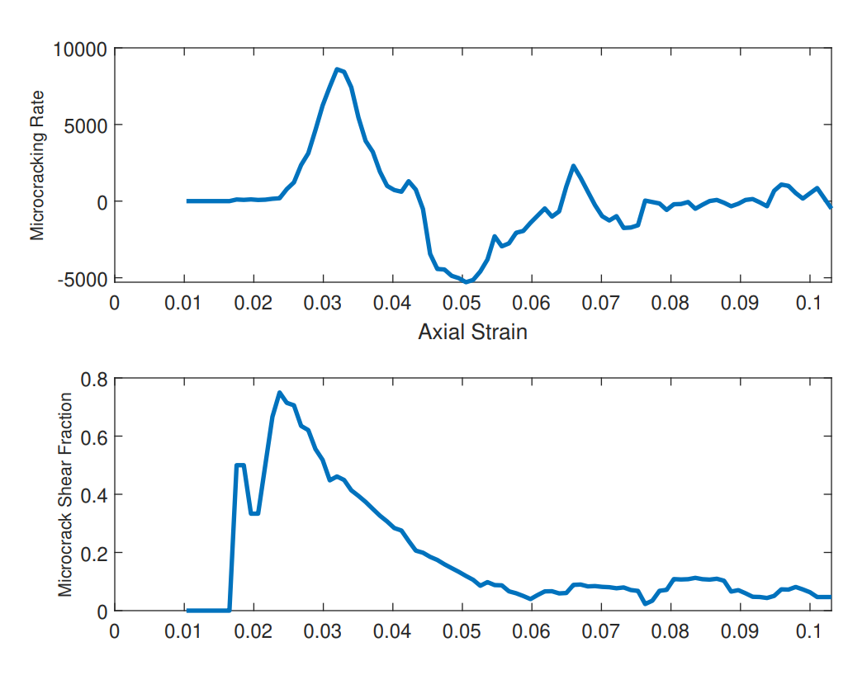
Results 1: Microcrack Growth
Potential precursors to failure:
Increase in Microcracking Rate prior to failure
Peak Shear microcracking prior to failure

Slide 9
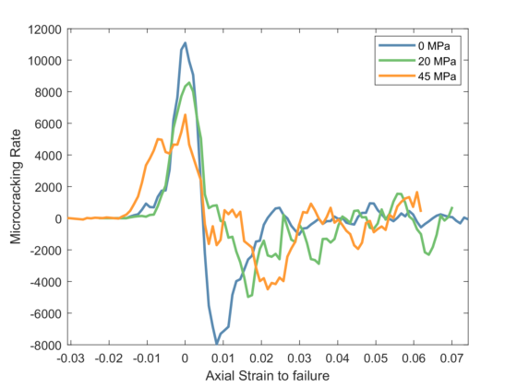
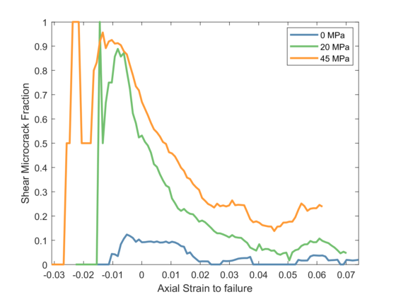
Results 1: Microcrack Growth
Potential precursors to failure:
Increase in Microcracking Rate prior to failure
Peak Shear microcracking prior to failure

Slide 10
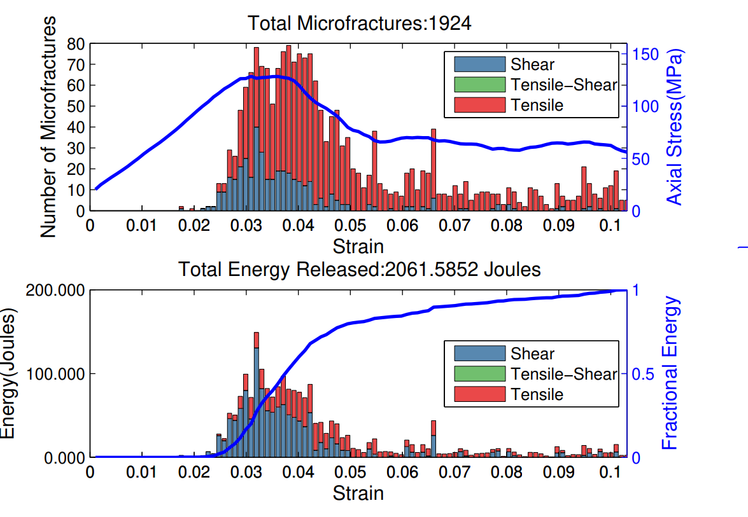
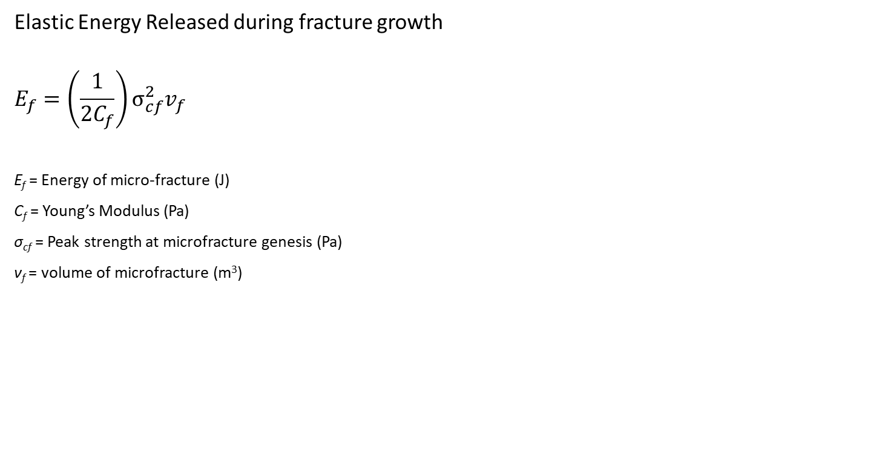
Methods 2: Fracture Energy
Elastic Energy Released during fracture growth
$$E_{f}=\left(\frac{1}{2C_{f}}\right)σ_{cf}^{2}v_{f}$$
E_{f} = Energy of micro-fracture (J)
C_{f} = Young’s Modulus (Pa)
σ_{cf} = Peak strength at microfracture genesis (Pa)
ν_{f} = volume of microfracture (m³)

Slide 11
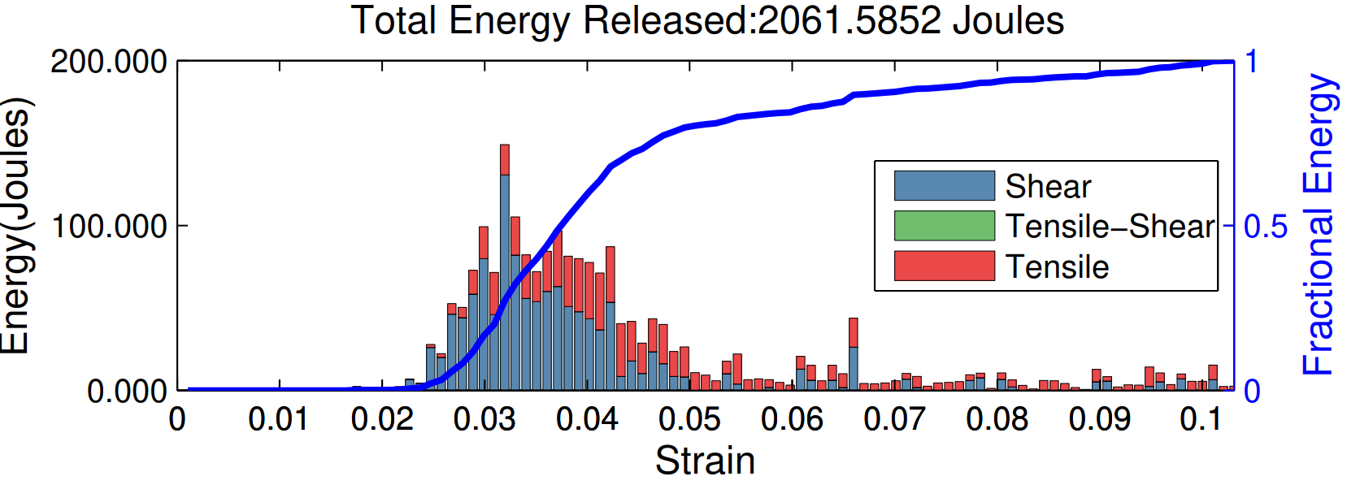
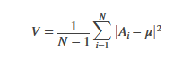
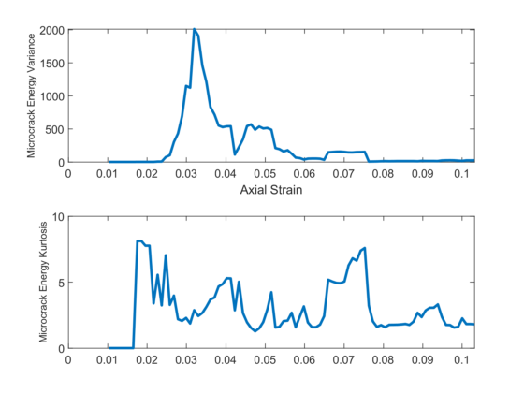
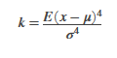
Results 2: Fracture Energy
Statistical Analysis:
Variance: Expectation of deviation from Mean
3. Kurtosis: Expectation of how outlier-prone a distribution is (similar to skewness)
Potential Fracture Energy precursors to failure:
High Variance in energy
Steep Decline in Kurtosis

Slide 12
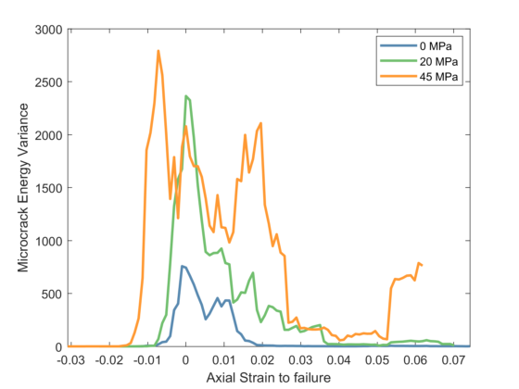
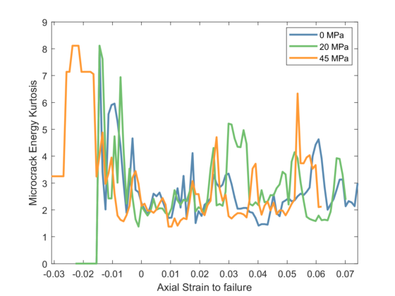
Results 2: Fracture Energy
Potential Fracture Energy precursors to failure:
High Variance
Decline in Kurtosis

Slide 13

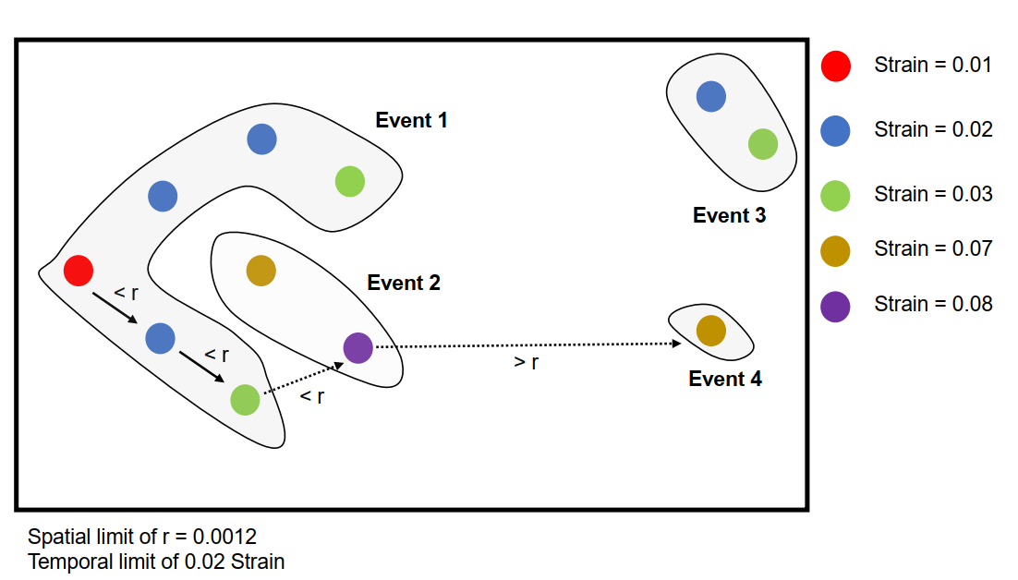
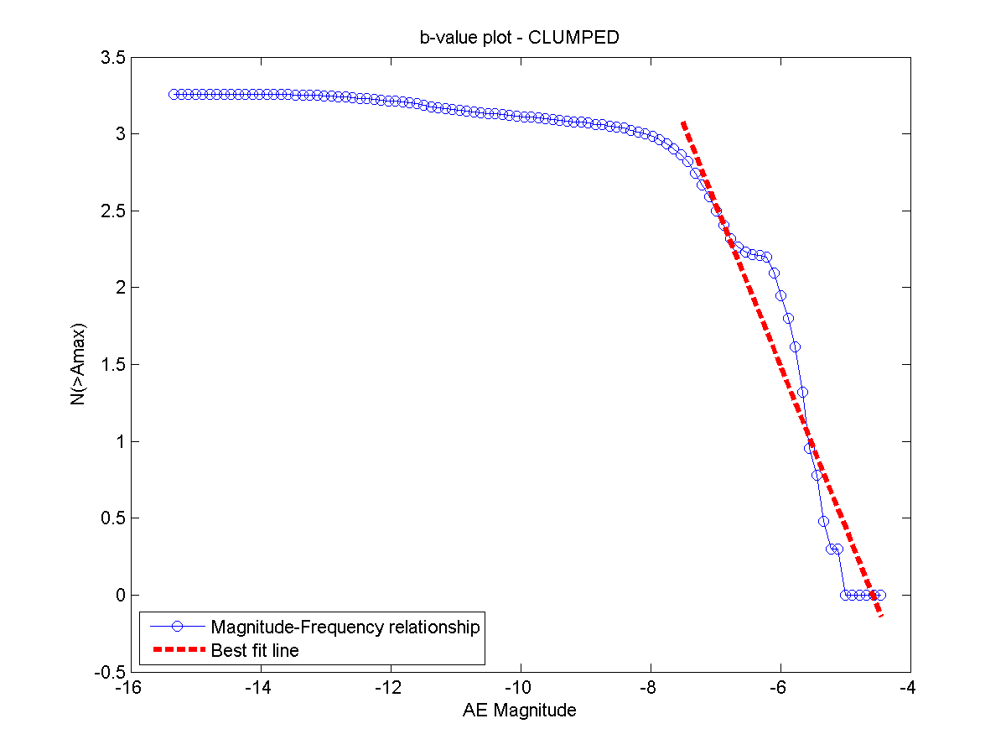
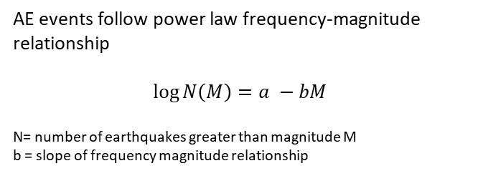
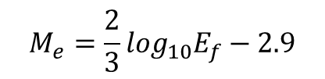
Methods 3: Moment Magnitude
Spatial and Temporal clustering of Microcracks
AE events follow power law frequency-magnitude relationship
$$\log{N\left(M\right)=a −bM}$$
N= number of earthquakes greater than magnitude M
b = slope of frequency magnitude relationship
$$M_{e}=\frac{2}{3}\log_{10}E_{f}−2.9$$

Slide 14
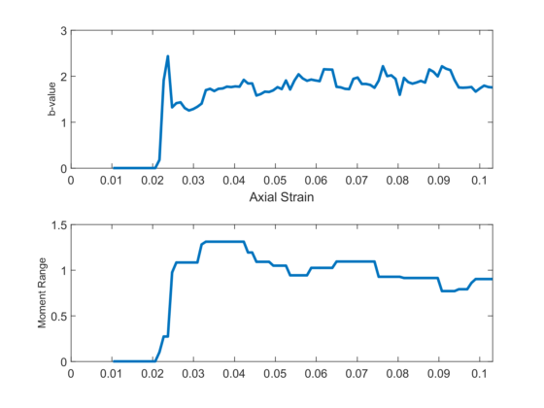
Results 3: b-value
Potential Moment precursors to failure:
Decline in b-values prior to failure
Increase in range of seismic moments

Slide 15
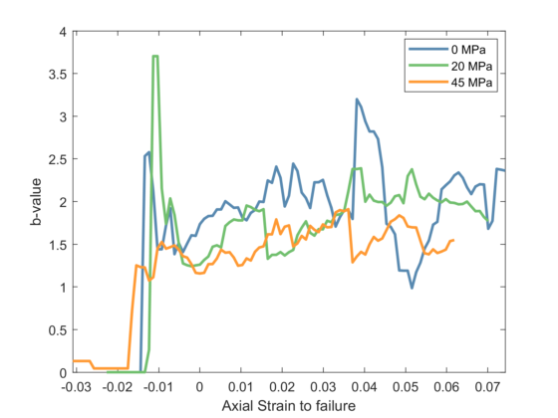
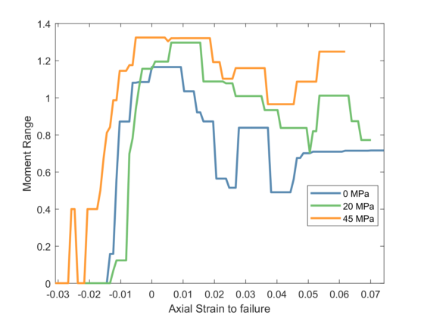
Results 3: b-value
Potential Moment precursors to failure:
Decline in b-values prior to failure
Increase in range of seismic moments

Slide 16
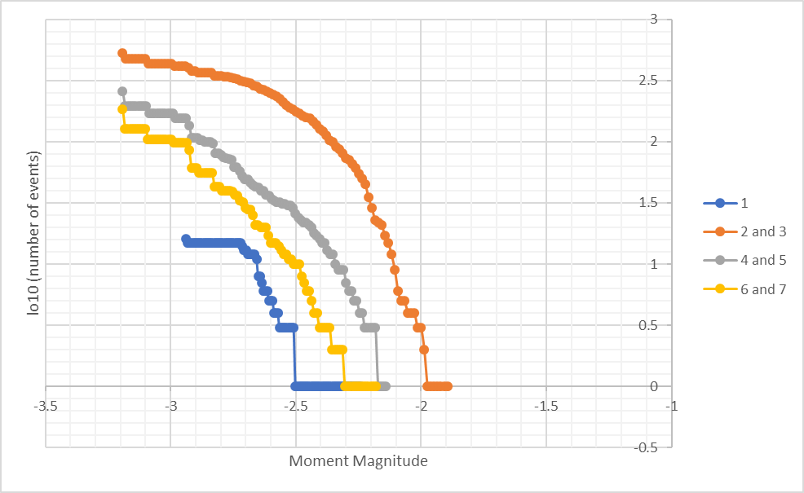
Why does b-value change?
2
3
1
4
5
6
7
6
7
4
5
3
2
1
Potential Moment precursors to failure:
Decline in b-values prior to failure
Increase in range of seismic moments

Slide 17
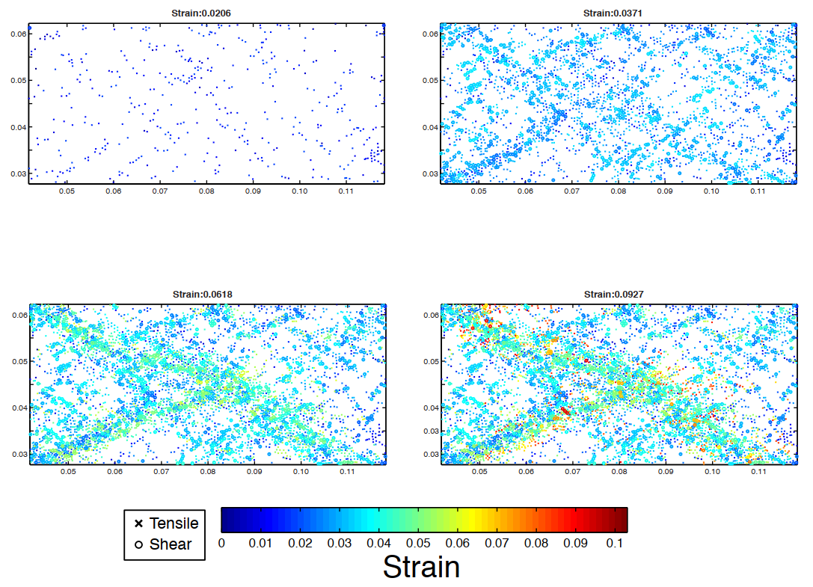
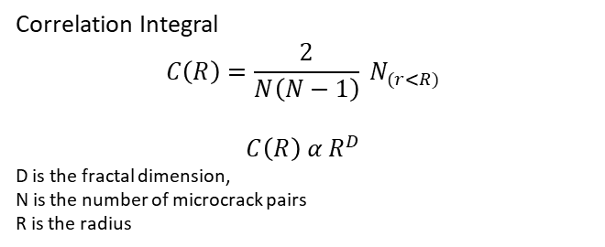
Methods 4: Fractal Dimension
Correlation Integral
$$C\left(R\right)=\frac{2}{N\left(N−1\right)} N_{(r<R)}$$
$$C\left(R\right) α R^{D}$$
D is the fractal dimension,
N is the number of microcrack pairs
R is the radius
2
3
1
4
5
6
7
1
3
5
7
High D-value: Distributed Damage
Low D-value: Localized Damage

Slide 18
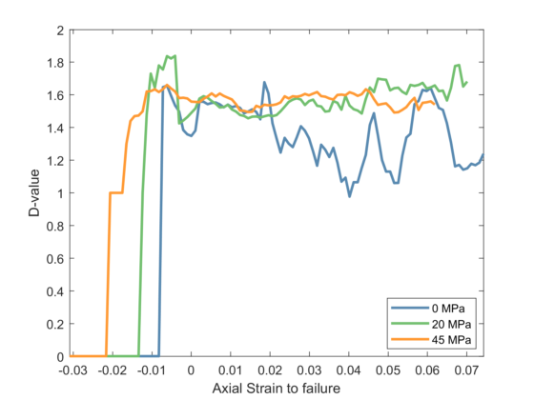
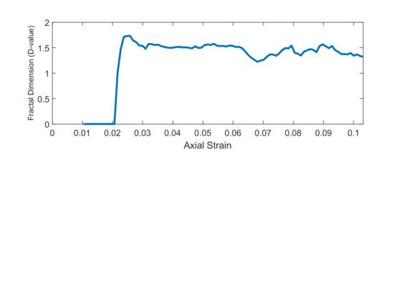
Results 4: D-value
2
3
1
4
5
6
7
Potential Damage precursors to failure:
Decline in Fractal Dimension

Slide 19
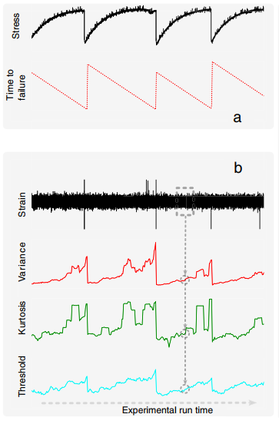
Summary of Precursory Signatures
Microcracking Activity:
High Rate
High Shear microcracking
Energy
High Variance
Moment:
Low b-values
Increase in moment range
Decline in D-values

Slide 20

Predicting Rock Failure using Neural Networks
7 Inputs:
Microcracking Rate
Microcracking Shear Fraction
Variance of Fracture Energy
b-value
Moment Range
D-value
Confining Pressure on Rock
Outputs:
Axial Stress to Failure
Axial Strain to Failure

Slide 21
Predicting Rock Failure using Neural Networks
Axial Stress to Failure
Axial Strain to Failure
Inputs from 0 to 50 MPa:
Microcracking
Energy
Moment
Fractal Dimension
Input dataset: [91 (samples) x10 (experiments)] x 7 (parameters)
[910 x 7]
Training: 70% of Dataset
Testing: 30% of dataset

Slide 22
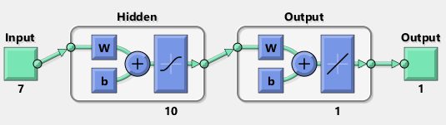
ML Result 1: Predicting Axial Stress to Failure
Targets
Training Predictions
Testing Predictions

Slide 23
Blind Test: 25 MPa Experiment
Post-failure
Pre-failure

Slide 24
ML Result 3: Predicting Axial Strain to Failure
Targets
Training Predictions
Testing Predictions

Slide 25
Blind Test: 25 MPa Experiment
Post-failure
Pre-failure

Slide 26
Summary
Identified statistical precursory signatures of deformation using:
Microcrack Growth (Rate of Microcracking)
Fracture Energy (Variance of Energy)
Moment magnitude (b-value and Moment Range)
Spatial Distribution of Microcracks (D-value)
Applied Neural Networks on precursory signatures to predict
Axial Stress to Failure
Axial Strain to Failure

Slide 27
Future Work
Optimize Neural Network Architecture
Add more features?
Investigate biases and weights
Hidden Layers and Number of Neurons
Improve Neural Network Predictions

